Slide 1
Walking optimization
Julian Whitman
4/6/2016

Slide 2
Fix the gait pattern
Gait pattern (order in which the legs will step) is fixed for now
Step size is fixed for now
Starting position of the feet and the tilt plane of the body with respect to the ground optimized.
Cost (on next slide)

Slide 3
Cost function & Constraint
Take the position of each foot just after it leaves the ground and just before it hits (nWalkingLegs*2 time points)
Penalize distance of CoM outside polygon
Penalize the CoM of each module/link being too close to eachother (collisions)
Penalize having the footsteps overlap (prevent self-tripping)
Nonlinear constraint: Feet must be within reachable workspace (approximated as a sphere around the shoulder)

Slide 4
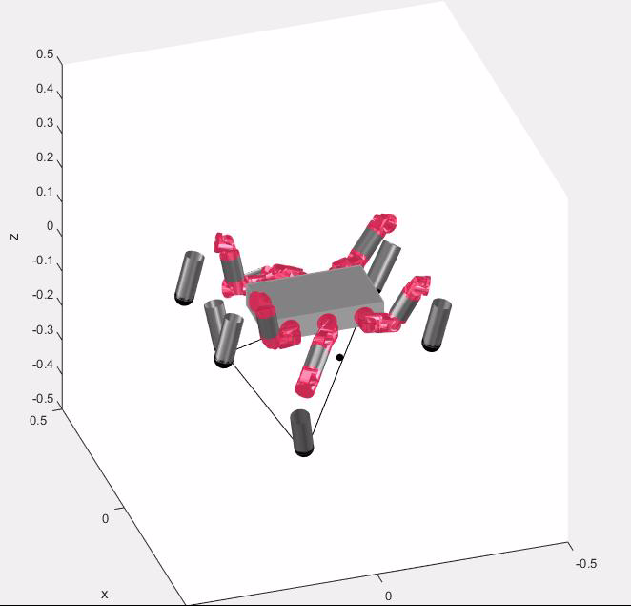
Results: 4 legs (still a moment of instability)

Slide 5
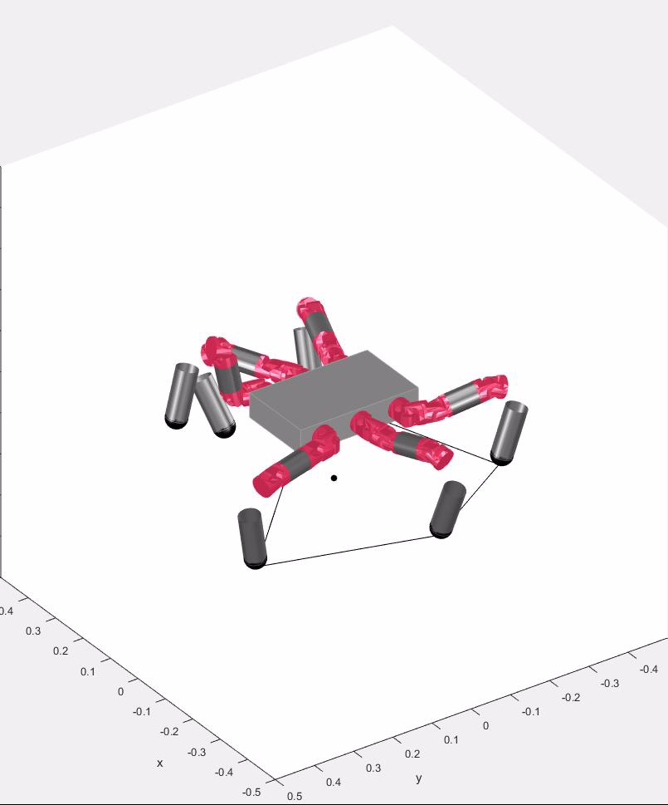
Results: 5 legs

Slide 6
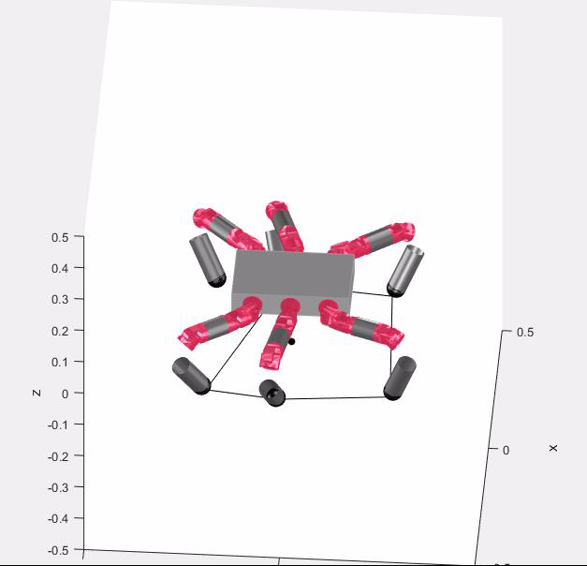
Results: 6 legs

Slide 7
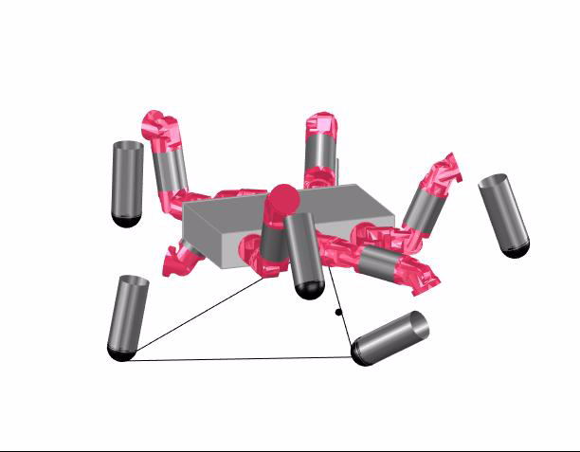
Letting the arms move around helps a little

